Slide 1
Automated Detection and Classification of 3D Printing Failures Using Image Processing and Deep Learning
Khang Duong
CS 898BA

Slide 2
Problem Statement
Problem:
  Failures may happen during long print jobs.
  3D printing failures waste time and materials.
  Early failure detection can reduce wasted filament and printing time.
Common Failure Types:
  Spaghetti
  Stringing
  Warping
Research Question: Can image processing and deep learning improve automatic detection of 3D printing failures?
Notes:
Many 3D printing jobs take several hours. If a failure occurs early and is not detected, the printer may continue wasting time and material. Spaghetti, stringing, and warping are several common failure types. Detecting these failures early could help a lot of people in reducing the wasted filament and printing time.
This project investigates whether image processing combined with deep learning can automatically detect these failures.

Slide 3
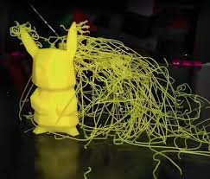
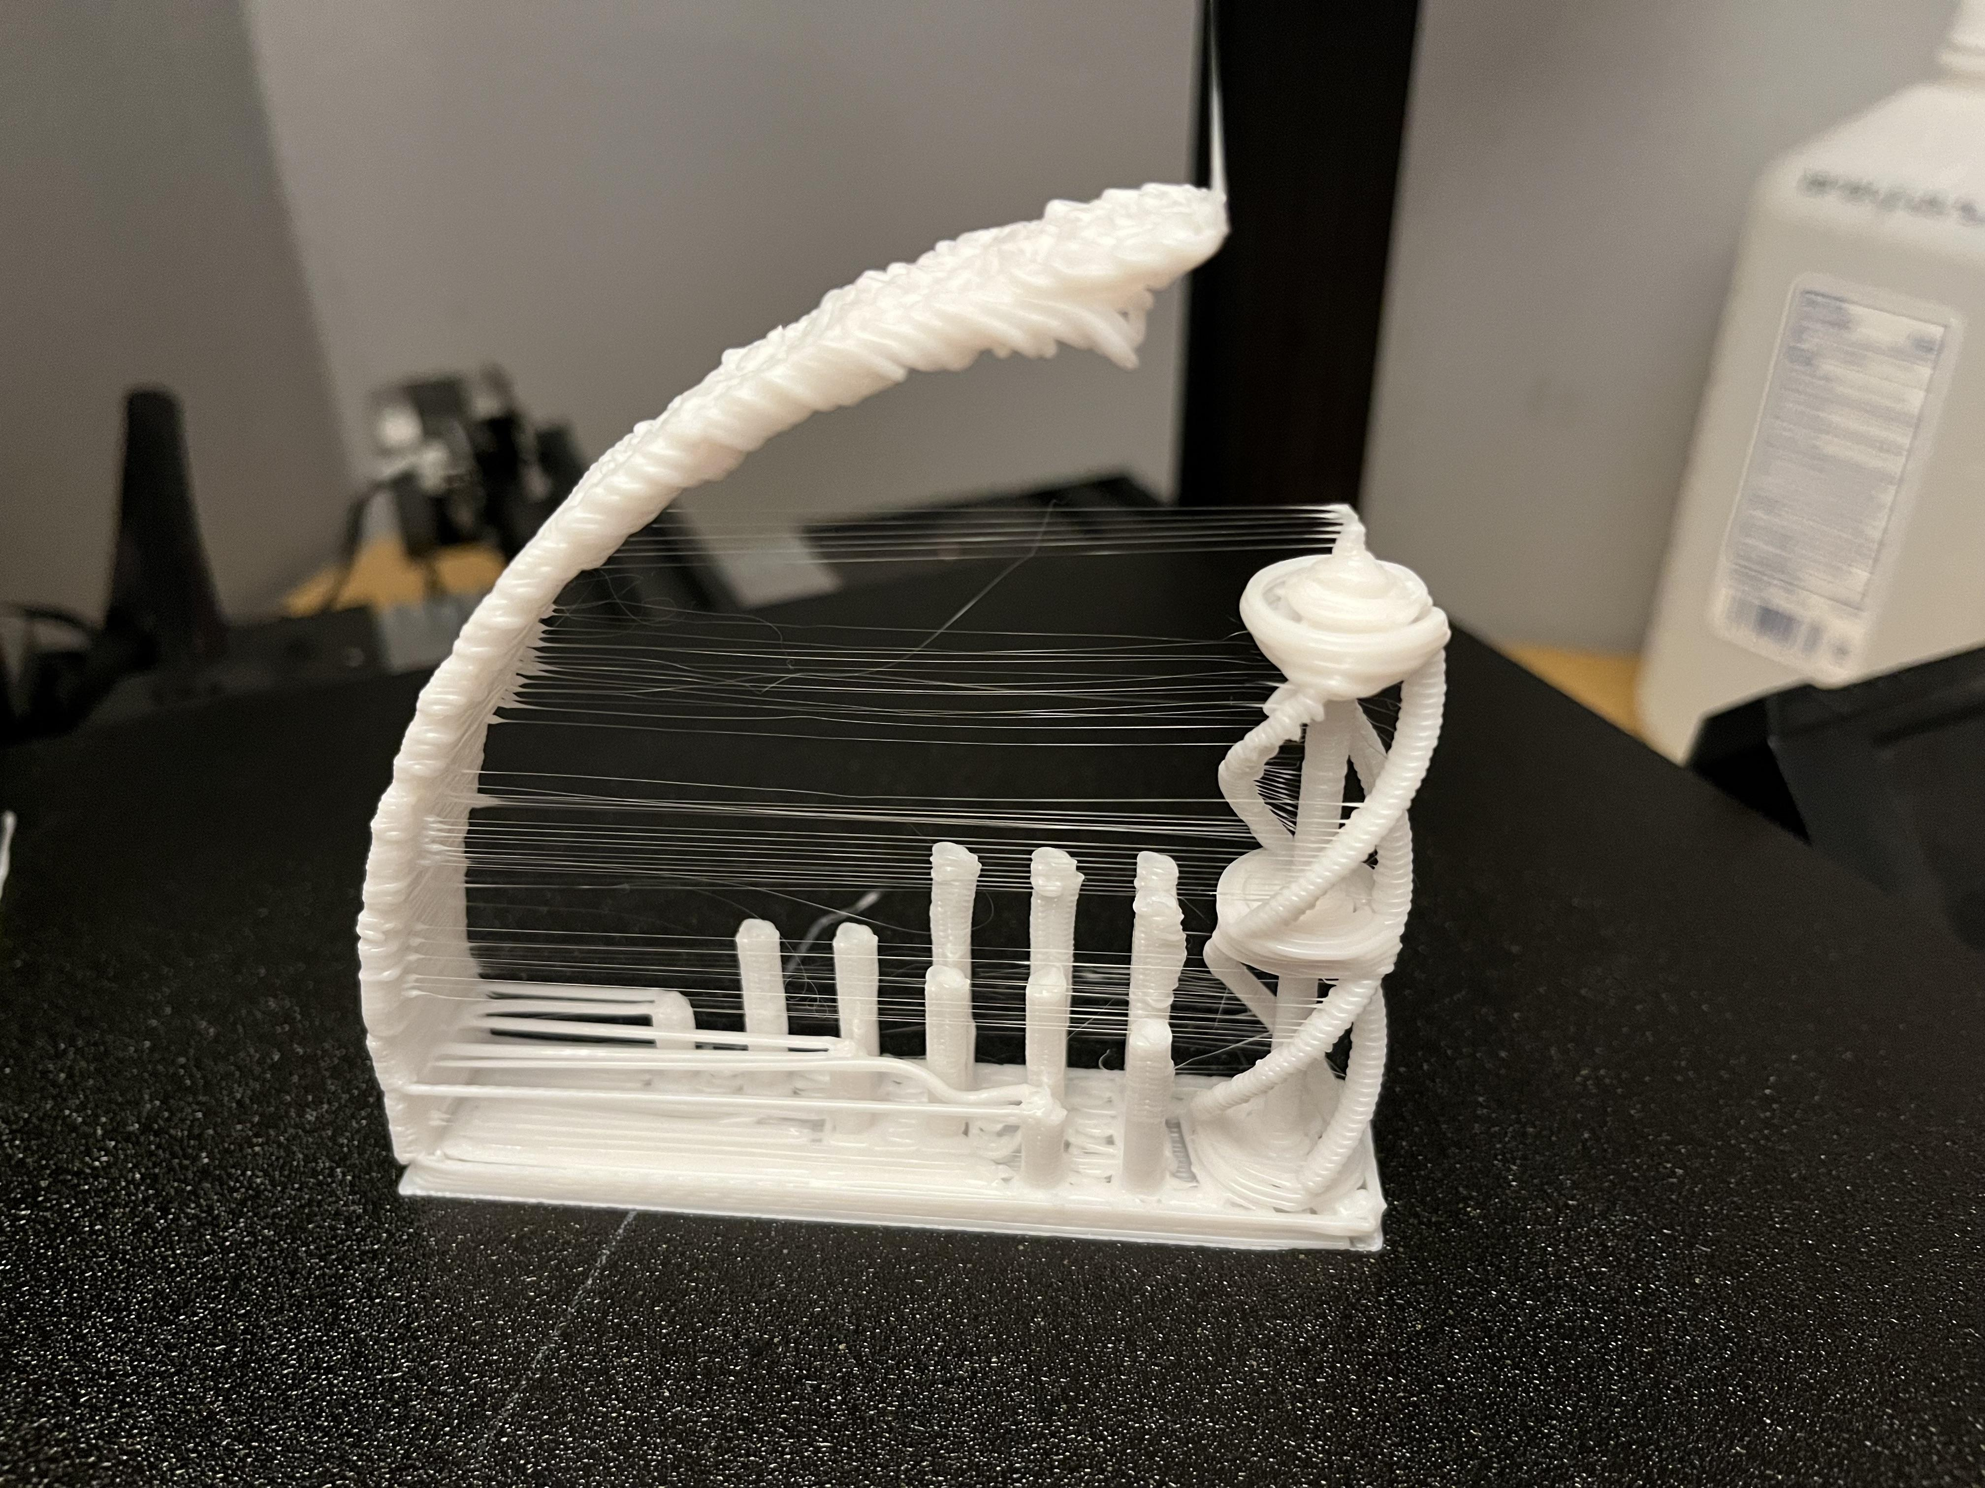
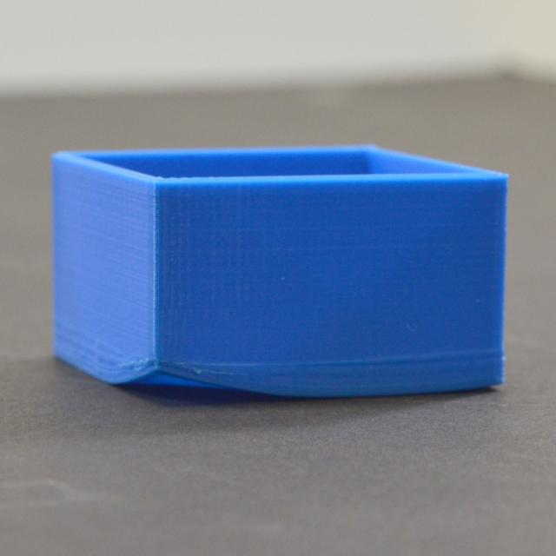
Dataset
Dataset Source:
  Roboflow: 3d print failure detection Computer Vision Model by Purvi Rathore
  4549 images:
    Train: 2696 images
    Validation: 1524 images
    Test 329 images
Classes:
  Spaghetti
  Stringing
  Warping

Slide 4
Preliminary Literature Review
Paper | Method | Contribution
YOLO26 | One-stage detector | Fast detection
Faster R-CNN | Two-stage detector | High accuracy
CLAHE | Image enhancement | Contrast improvement
Notes:
Existing work shows that deep learning object detectors perform well for industrial defects, while image enhancement techniques may improve feature visibility.

Slide 5
Alternative Design 1 - YOLO
Input Image → Image Processing → YOLO → Bounding Box → Class Prediction
Advantages:
  Fast
  Real-time capable
  High mAP
  Easy deployment
Disadvantages:
  May struggle with small defects
  Lower localization precision
  Sensitive to class imbalance
Notes:
YOLO is a one-stage detector that predicts bounding boxes and classes directly from the image.

Slide 6
Alternative Design 2 – Faster R-CNN
Input Image → Image Processing → CNN Backbone → Region Proposal Network (RPN) → ROI Pooling → Classification + Bounding Box Regression
Advantages:
  High localization accuracy.
  Strong performance on small and difficult objects.
  Precise bounding boxes.
  Widely used benchmark architecture.
Disadvantages:
  Slower inference
  Higher computational cost
  More complex architecture
Notes:
Faster R-CNN first proposes candidate regions and then classifies them, which often improves localization accuracy.

Slide 7
Proposed Image Processing Pipeline
Baseline: RGB → Model
Method 1: RGB → LAB → CLAHE → Model
Method 2: RGB → LAB → CLAHE → Canny Edge Detection → Model
Notes:
I want to investigate whether image preprocessing improves defect detection performance compared to using raw RGB images.

Slide 8
Choice Justification and Future Work
Model Selection:
  YOLO (Primary Model): Fast inference, Suitable for real-time 3D printing monitoring, Efficient for deployment
  Faster R-CNN (Comparison Model): Higher localization accuracy, Better performance on small defects, Slower inference speed
Evaluation Metrics:
  mAP@50 (primary detection accuracy)
  mAP@50–95 (strict evaluation)
  Precision (reduce false positives)
  Recall (reduce missed failures)
  IoU (bounding box accuracy)

Slide 9
References
Hidayatullah, P., & Tubagus, R. (2026). YOLO26: A Comprehensive Architecture Overview and Key Improvements. arXiv:2602.14582. https://arxiv.org/abs/2602.14582
Ren, S., He, K., Girshick, R., & Sun, J. (2015). Faster R-CNN: Towards Real-Time Object Detection with Region Proposal Networks. arXiv:1506.01497. https://arxiv.org/abs/1506.01497
Mishra, A. (2021). Contrast Limited Adaptive Histogram Equalization (CLAHE) Approach for Enhancement of the Microstructures of Friction Stir Welded Joints. arXiv:2109.00886. https://arxiv.org/abs/2109.00886
Rathore, P. (2026). 3D Print Failure Detection – Object Detection Dataset. Roboflow Universe.
https://universe.roboflow.com/purvi-rathore-5amqh/3d-print-failure-detection-efvsh/dataset/4
License: CC BY 4.0

